Slide 1

Budgeting at times of high inflation
March 2023
The Czech Fiscal Council

Slide 2
Inflation in the Czech Republic
Inflation started to soar at the end of 2021.
Even before the Russian invasion, inflation in Czechia was close to 10%.
The central bank’s interest rate was close to zero during COVID-19.
The central bank began to raise its interest rate in the second half of 2021.
The interest rate was raised to 7% in July 2022 and has stayed there ever since.

Slide 3

Public finances in Czechia before the energy crisis and high inflation
Even before the energy crisis, Czechia had been living through a period of fiscal expansion and fiscal imbalances.
The central government budget has recently been ending in huge deficits:
  2020: CZK 367 billion (6.5% of GDP)
  2021: CZK 419 billion (6.9% of GDP)
  2022: CZK 360 billion (5.3% of GDP)
The deficits are not predominantly due to one-off Covid-19 measures but to measures influencing the structural balance.
For example, the 2020 personal income tax cut means CZK 100 billion less in revenue.

Slide 4
How does inflation affect public finances?
Public revenues
Both positive and negative effects can appear.
Value added tax is influenced by both effects.
  Higher prices mean higher tax and therefore higher revenue.
  Higher prices mean a decrease in consumption and therefore lower revenue.
  In 4Q 2022, real household consumption expenditure dropped by 5.5% (y/y).
Personal income tax and social security contributions
  The increase in these revenues depends on the dynamics of wages, in other words, how much wages keep pace with inflation.
  In 2022, the average wage grew by 6.5% (CPI 15.1%).

Slide 5
How does inflation affect public finances?
Public expenditures
Expenditure indexation
The increase in expenditure depends on how strong the indexation of pensions, social benefits and public sector salaries is.
Energy prices
Increase in expenditure due to capping of prices of electricity and gas for households and companies + aid for firms in energy-intensive industries.
Increase in expenditure because of purchase of natural gas for state material reserves + more expensive intermediate consumption.

Slide 6
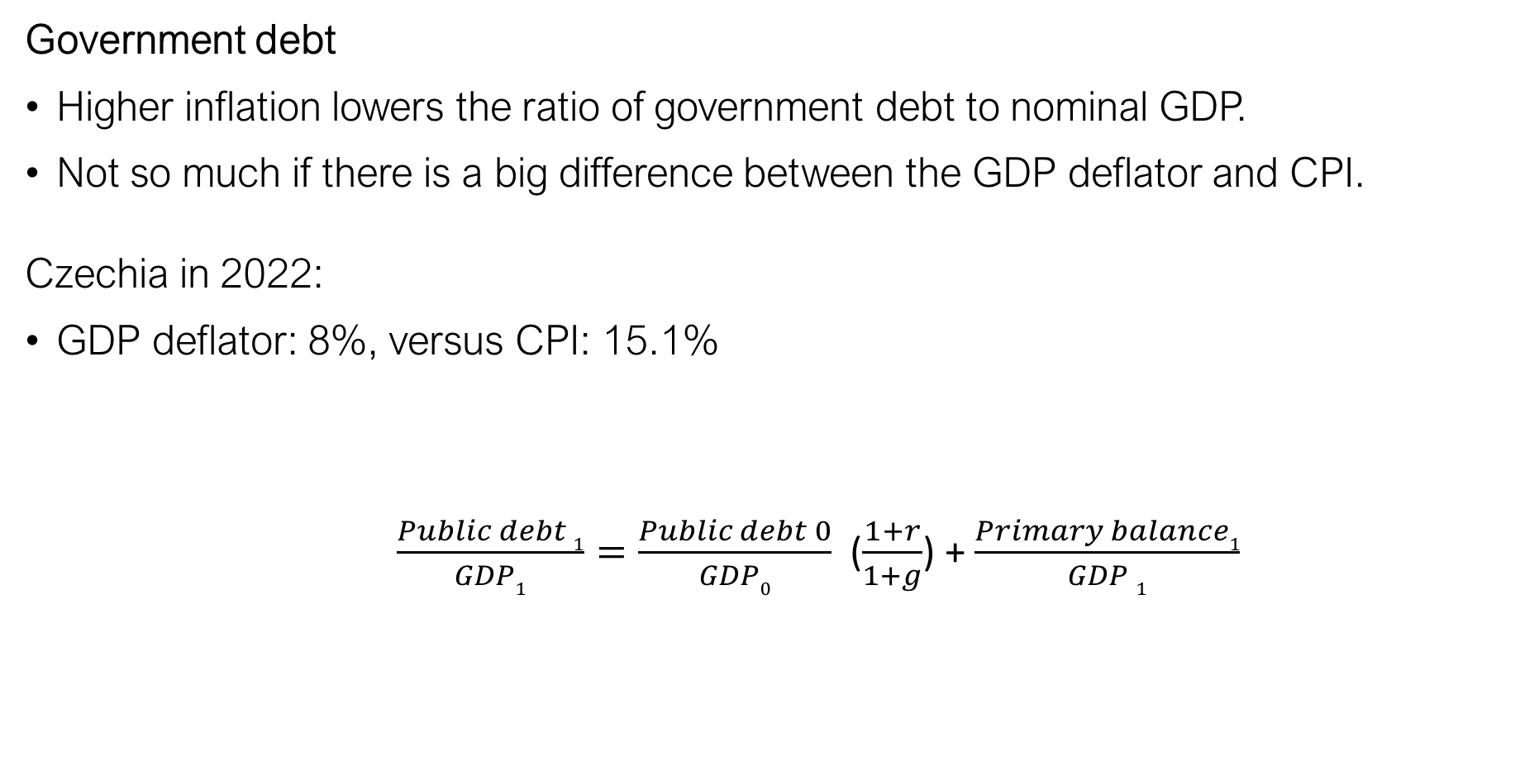
How does inflation affect public finances?
Government debt
Higher inflation lowers the ratio of government debt to nominal GDP.
Not so much if there is a big difference between the GDP deflator and CPI.
Czechia in 2022:
GDP deflator: 8%, versus CPI: 15.1%
$\frac{Public debt 1}{GDP1}=\frac{Public debt 0}{GDP0}$ ($\frac{1+r}{1+g}$) + $\frac{Primary balance1}{GDP 1}$
r = average interest rate on debt
r = 2.3%
g = GDP growth

Slide 7
How does inflation affect public finances?
Pensions
Pensions are valorised according to the following formula:
Valorisation of pensions = CPI (whole) + ½ of growth of real wages
The law also imposes extraordinary valorisation if CPI exceeds 5 percentage points in the year-on-year index since the last valorisation (typically in June).
The average pension increased by 17% between 2021 and 2022 and by 24.7% between 2020 and 2022.
Anti-inflation government bonds
Starting in 2019, individuals were able to buy anti-inflation government bonds.
This programme was stopped at the end of 2021. But interest costs obviously remain…

Slide 8
Discretionary measures adopted by the Czech government in 2022–2023
Cancellation of road tax (CZK 5 billion yearly): 0.07% of GDP
Reduction of excise duty on fuel (CZK 10 billion yearly): 0.15% of GDP
One-off child allowance (CZK 7 billion): 0.1% of GDP
One-off household electricity allowance (CZK 17 billion): 0.25% of GDP
Waiver of payment for renewables (CZK 23 billion): 0.34% of GDP
Capping of electricity and gas prices (CZK 100 billion): 1.47% of GDP
Aid for firms in energy-intensive industries (CZK 30 billion): 0.44% of GDP
Windfall tax + levies on excess income in energy sector (CZK 100 billion): 1.47% of GDP

Slide 9
Structure of the state budget in 2023
Social security contributions
Social benefits
Indexation to CPI
Value added tax
Promise of 130% of average wage for all teachers
Education
Corporate income tax
Pressure to increase due to inflation
Salaries (excluding education and healthcare)
Excise duty
Personal income tax
Payment to health insurance companies
Indexation to CPI
Windfall tax + levies on excess profits
Energy price cap + aid for firms
Intermediate consumption
Expensive services and energy
Interest payments
Higher due to higher CB rates
CZK 1,928 billion
CZK 2,223 billion
CZK -295 billion (4% of GDP)

Slide 10
Unexpected effects of high inflation on the indexation of social benefits
Due to this formula:
Valorisation of pensions = CPI (whole) + ½ of growth of real wages
Real wages are only accounted for if their growth is positive. If it is negative, they are not accounted for and pensions are valorised by the whole CPI.
In the current period of high inflation (15.1%) and a huge decrease in real wages, the replacement rate is soaring. The gap between the average wage and the average pension is closing…
There is an ongoing discussion about a new pension valorisation formula.

Slide 11
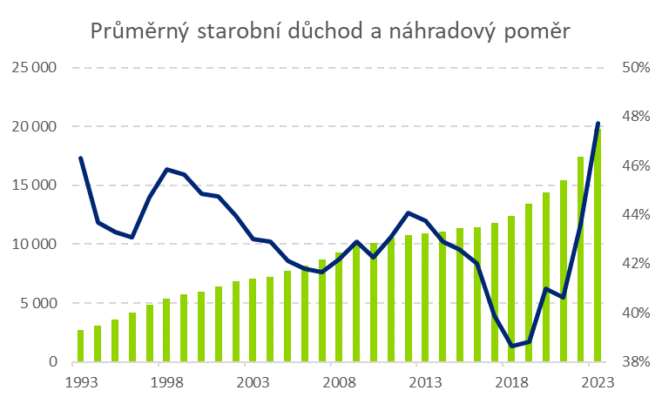
Average pension (left scale) and replacement rate (right scale)

Slide 12

Thank you for your attention

